Slide 1
Transformer-based Satellite Image and Segmentation Generation for Ground-to-Aerial Image Matching
Computer Vision 2024-2025
Alessia De Vecchis
Andrea Lattaro
Federico Miscione

Slide 2
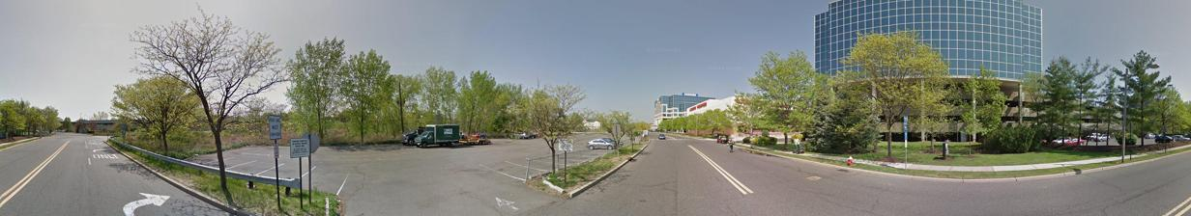
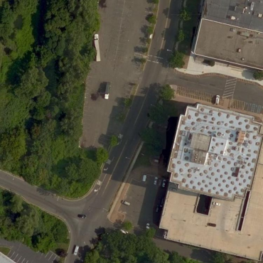
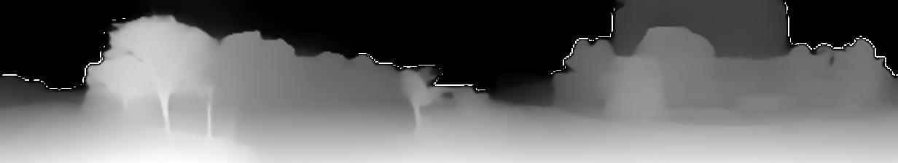
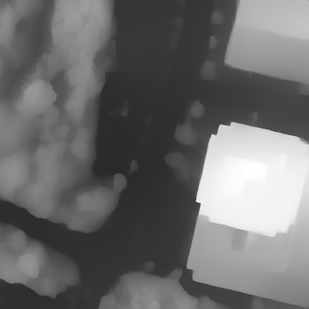


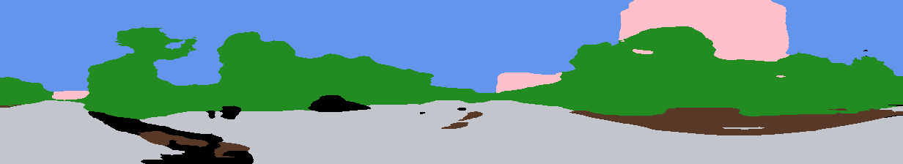

CVUSA Dataset
CVUSA subset
New Dataset
Ground
Ground
Aerial
Aerial
Depth map
Depth map
Segmentation
New Segmented
Sift
Sift

Slide 3
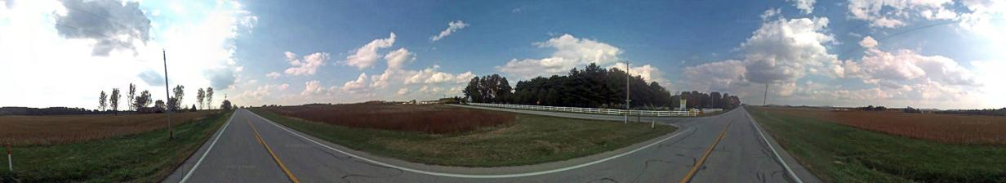
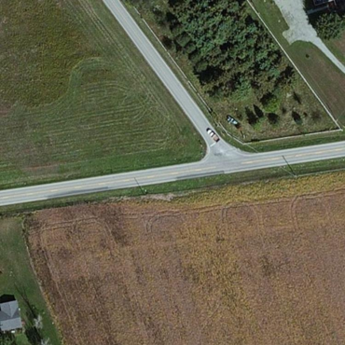
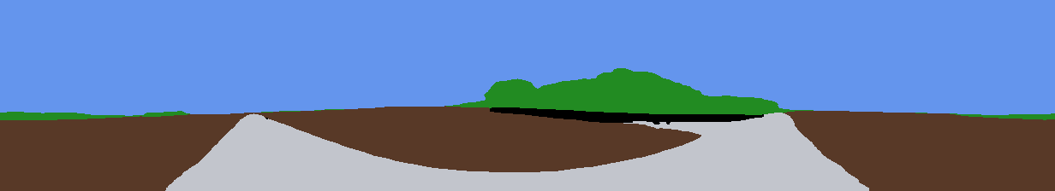
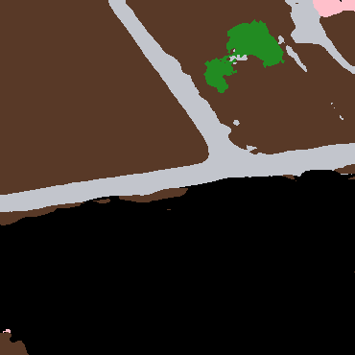
Challenge: Original images segmentation
Pretrained transformer architecture for segmentation of street view images mapped grouping classes of interest into seven selected ones
SegFormer
Buildings | Sky | Tree | Road | Field | Water | Sand

Slide 4
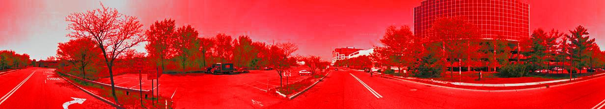
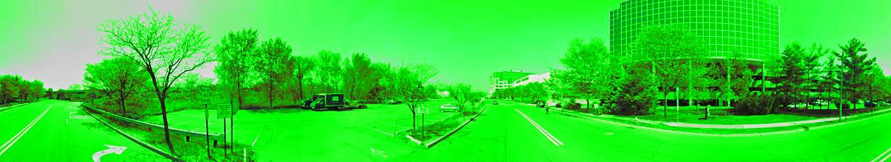
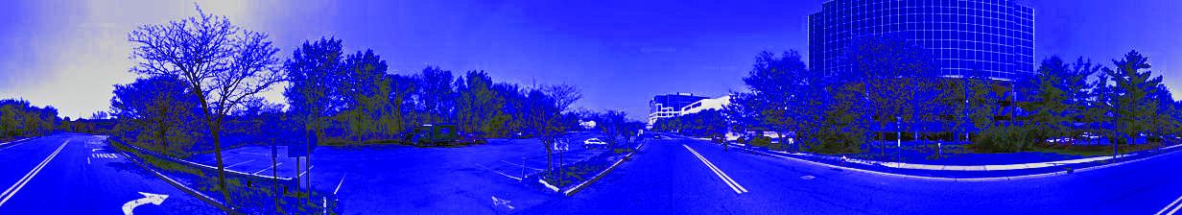
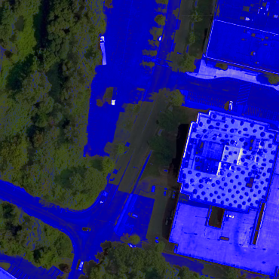
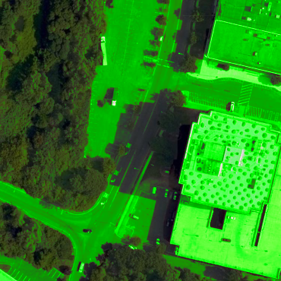
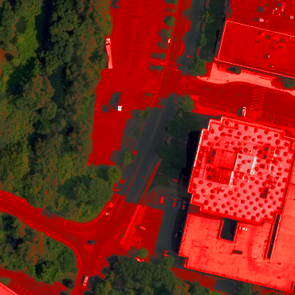
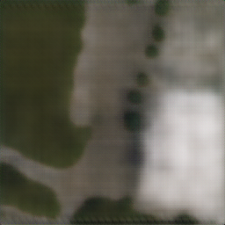
Workflow synthetic image generation
Input: 5 channels images
SwinGenerator
RGB
Labels
Satellite
Synthetic
Ground
Segmentation
SegFormer
RGB
Depth map
Ground Depth Map
Segmentation

Slide 5
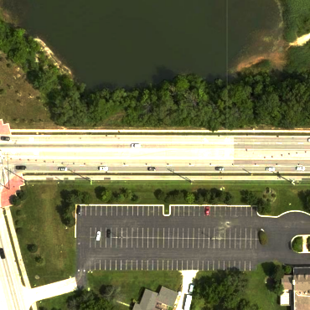
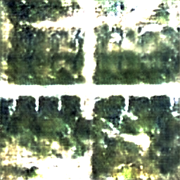
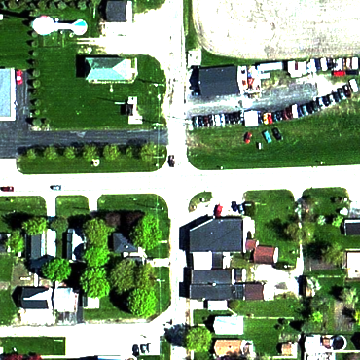
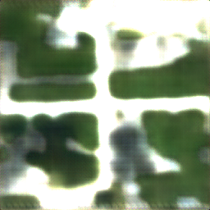
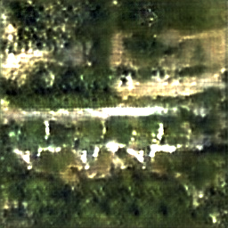
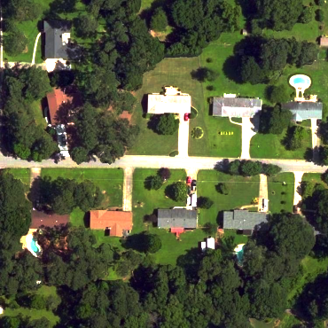
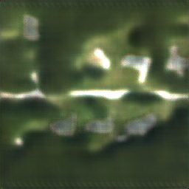
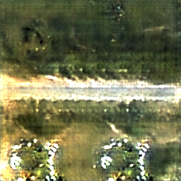
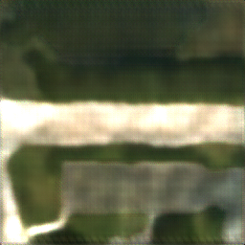
SwinGenerator evaluation
Rural Example
Urban Example

Slide 6
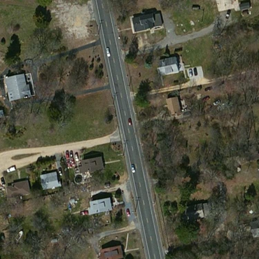
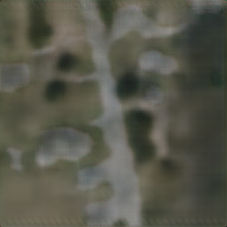
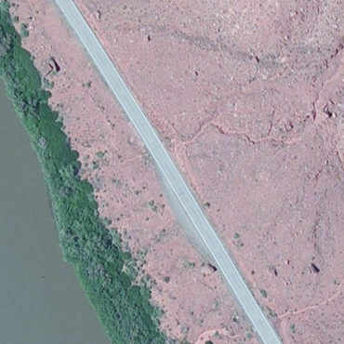
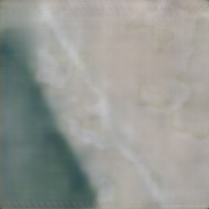
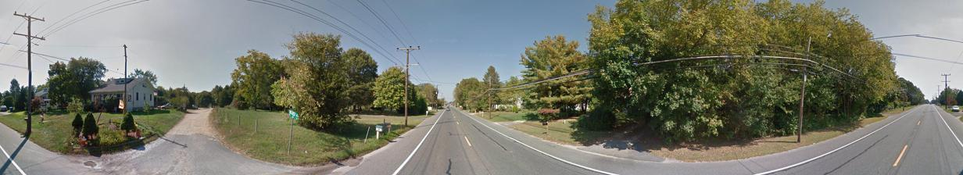
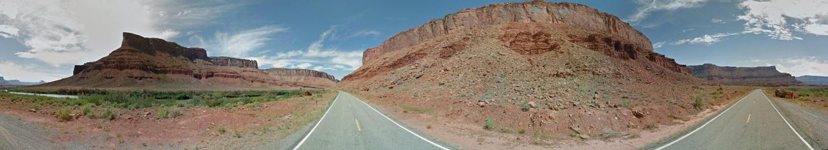
Other examples
Urban example
Rural example

Slide 7
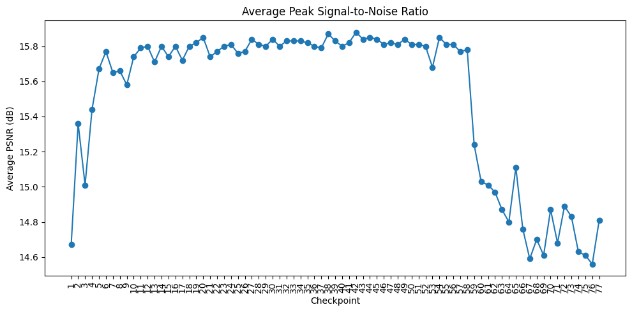
Peak Signal-to-Noise Ratio
Evaluation

Slide 8
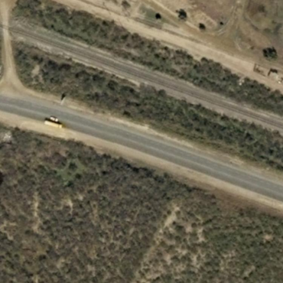

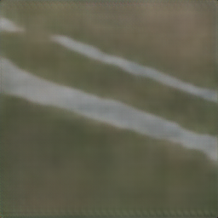
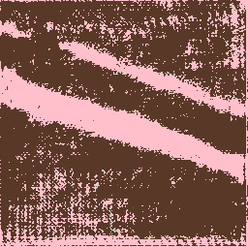
SegUNet: Synthetic images segmentation
Fine-tuning
Synthetic images segmentation
5 epochs
Sharpening + saturation boost to reduce smoothness and enhance clarity
Original Satellite
SegFormer
Segmented
Synthetic Satellite
SegUNet Segmented
Input
Target
Input
Result

Slide 9
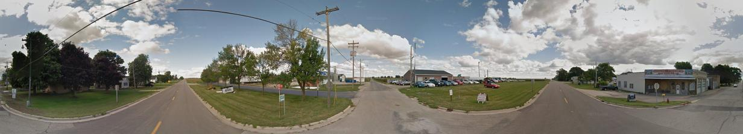
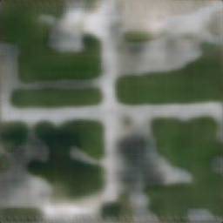
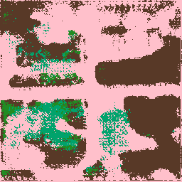
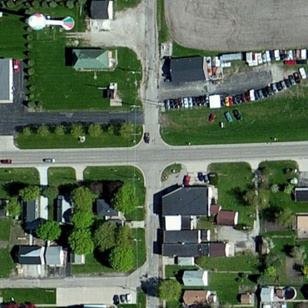
Localization task ground-aerial
Ground
GeolocalizationNet
JointFeatureNet:
Features Extraction
Features concatenation
FeatureFusionNet:
Embedding task
Weighed Triplet Loss:
Triplet_term= (Ef-Ep)-(Ef-En)
Aux_term=(Es-Ep)
loss= Triplet_term+Aux_term
Generation Task
Output:joint_feature
SwinGenerator
Synthetic
Segmentation
Output:Embedding
SegUNet
Aerial positive
Aerial negative

Slide 10
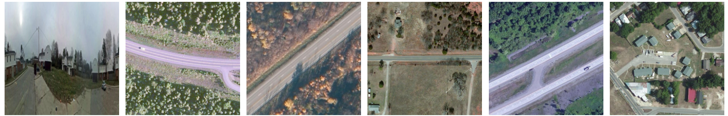
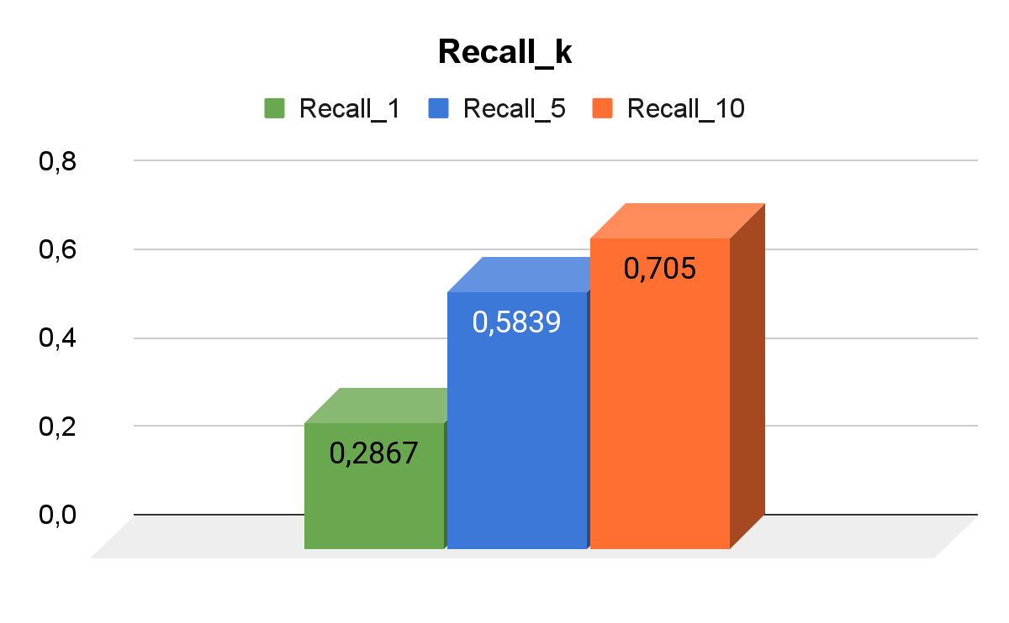
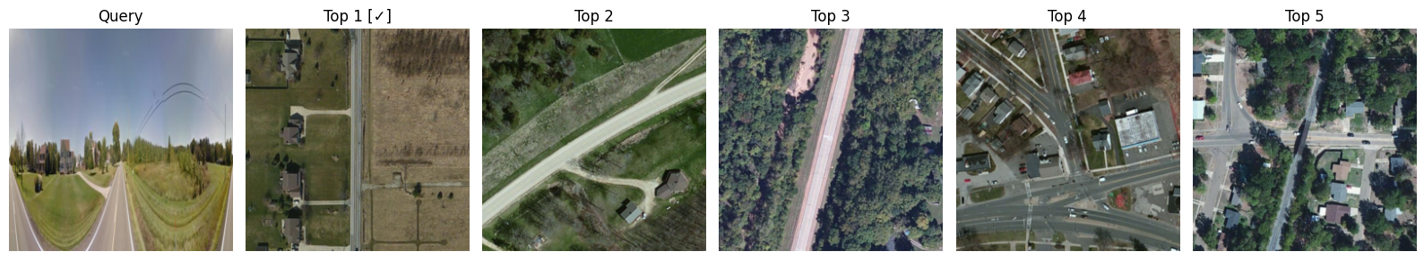
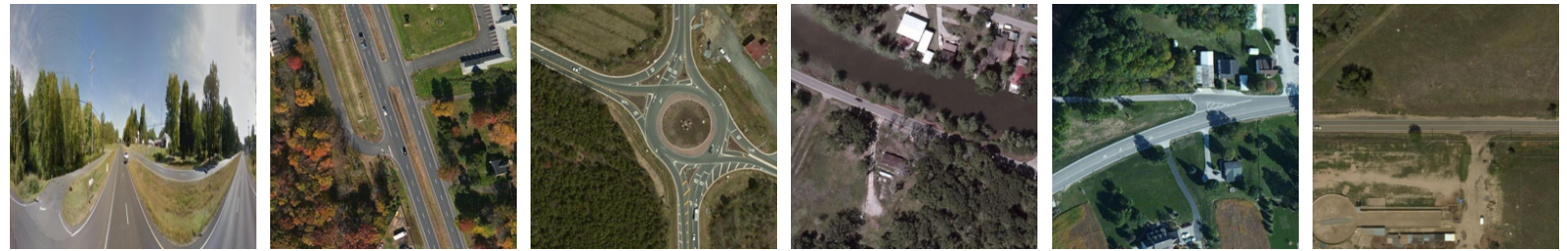
Results
Grounds
Top 1
Top 2
Top 3
Top 4
Top 5

Slide 11
Results
A comparison of our model performance with the presented architectures in the papers
 | Recall 1 | Recall 5 | Recall 10
Regmi et al. | 48.75 % | - | 81.27 %
SAN | 77,07 % | 92,14 % | 95,62 %
SAN-QUAD | 82,85 % | 94,81 % | 96,52 %
GeolocalizationNet (ours) | 28.67 % | 58.39 % | 70.50 %
1
2
3
References:
Regmi, K., & Shah, M. (2019). Bridging the Domain Gap for Ground-to-Aerial Image Matching. arXiv.
F. Pro, N. Dionelis, L. Maiano, B. L. Saux and I. Amerini, ”A Semantic Segmentation-Guided Approach for Ground-to-Aerial Image Matching,” IGARSS 2024 - Athens, Greece, 2024, pp. 2630-2635.
Mule, E., Pannacci, M., Goudarzi, A., Pro, F., Papa, L., Maiano, L., and Amerini, I. (2025). Enhancing Ground-to-Aerial Image Matching for Visual Misinformation Detection Using Semantic Segmentation. In Proceedings of the Winter Conference on Applications of Computer Vision (WACV) Workshops (pp. 795-803).

Slide 12

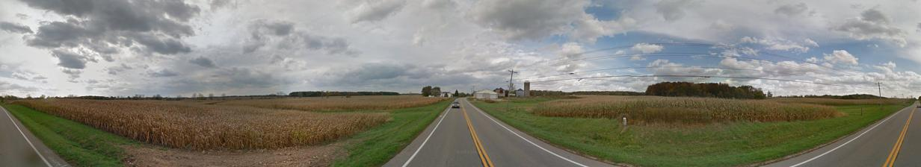

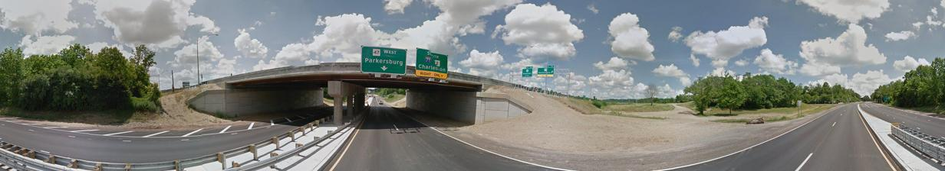
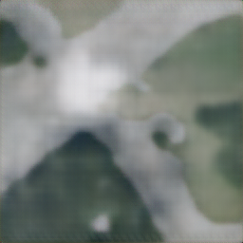
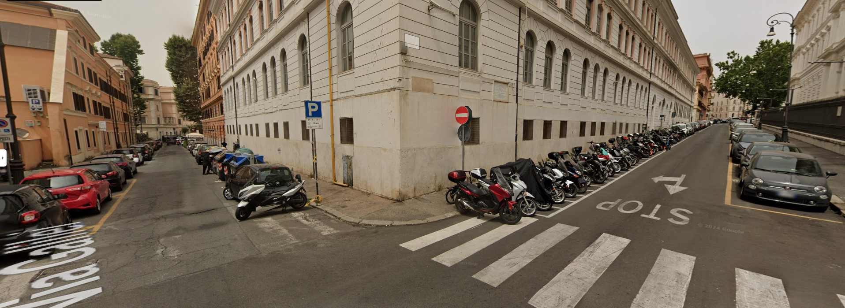
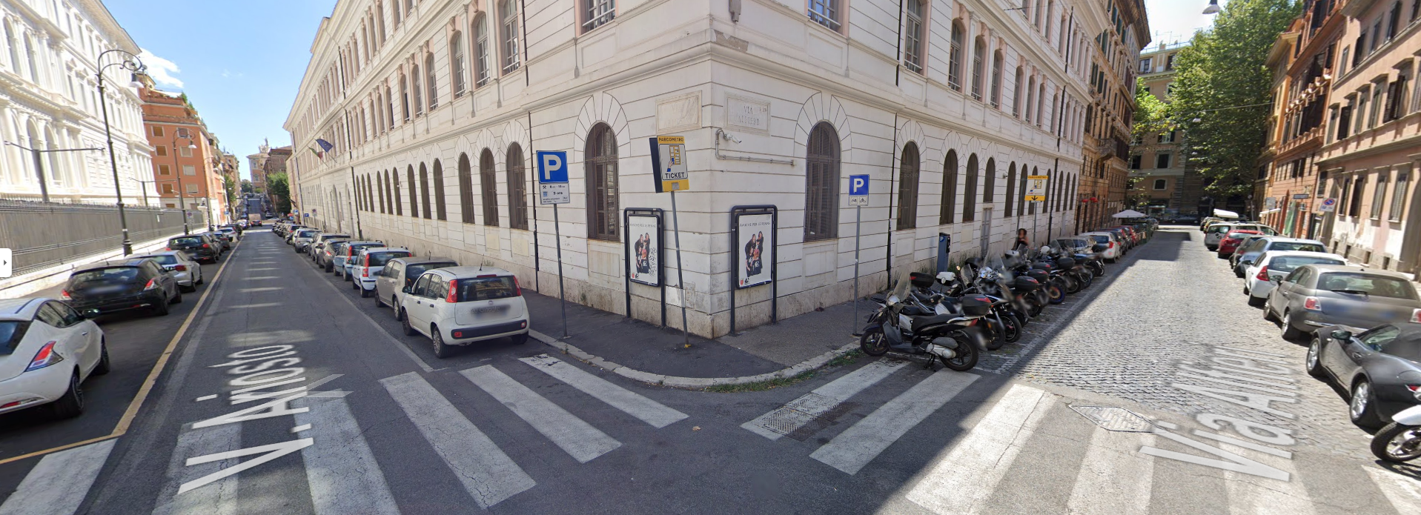
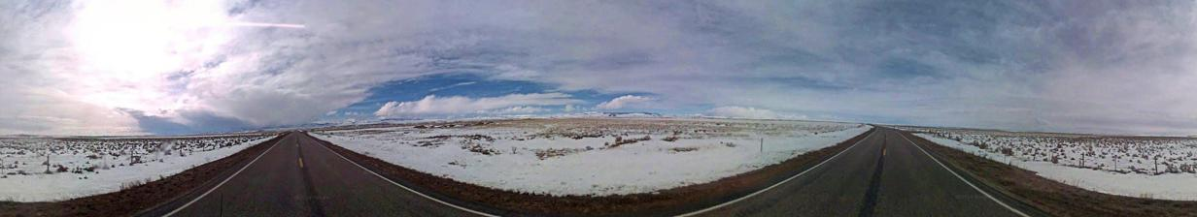

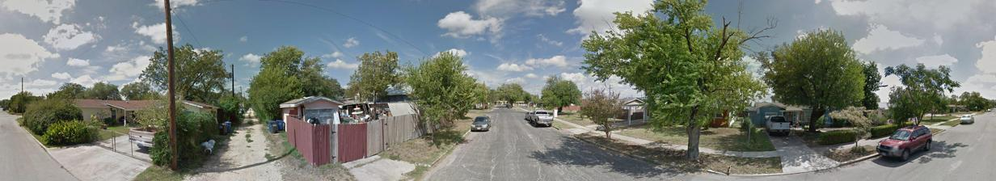

Conclusion
Future works
Precision agriculture
Integrating more data sources
3d model
more angle views
Complete version dataset
more items
more quality
Disaster events
Environment monitoring
Defence and security

Slide 13
References
Regmi, K., & Shah, M. (2019). Bridging the Domain Gap for Ground-to-Aerial Image Matching. arXiv.
F. Pro, N. Dionelis, L. Maiano, B. L. Saux and I. Amerini, ”A Semantic Segmentation-Guided Approach for Ground-to-Aerial Image Matching,” IGARSS 2024 - Athens, Greece, 2024, pp. 2630-2635.
Mule, E., Pannacci, M., Goudarzi, A., Pro, F., Papa, L., Maiano, L., and Amerini, I. (2025). Enhancing Ground-to-Aerial Image Matching for Visual Misinformation Detection Using Semantic Segmentation. In Proceedings of the Winter Conference on Applications of Computer Vision (WACV) Workshops (pp. 795-803).

